Slide 1
How do we grow?

Slide 2
How do we grow?

Slide 3
How do we grow better?

Slide 4
How do we grow better?

Slide 5
How do we grow worse?

Slide 6
How do we grow worse?

Slide 7
Kevin Tran presents:
Spiraling out
A machine-learning-driven thought experiment to investigate human growth

Slide 8
Spiraling out
Using Bayesian optimization to grow human portraits for the better… or worse

Slide 9
Spiraling out
Using Bayesian optimization to grow human portraits for the better… or worse
What is “growth”?
What is “better” or “worse”?
How do we grow?

Slide 10
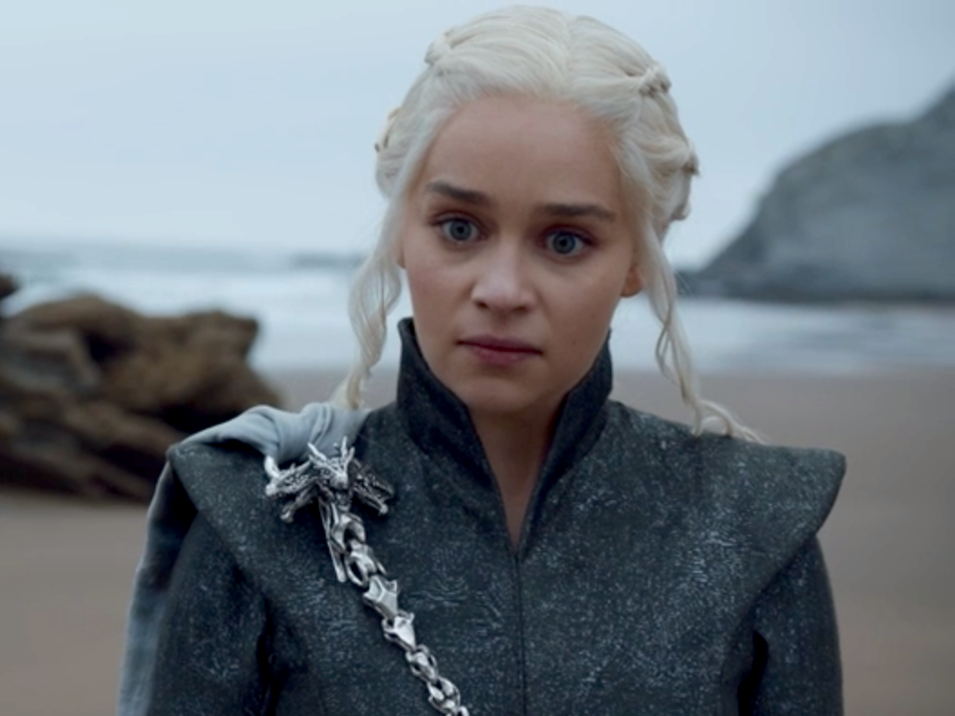
We use style transfer to symbolize a subject’s “growth”.
In essence, we imbue the subject with an experience—i.e., a style image.
subject
experience
experienced subject
+
What is “growth”?
What is “better” or “worse”?
How do we grow?

Slide 11
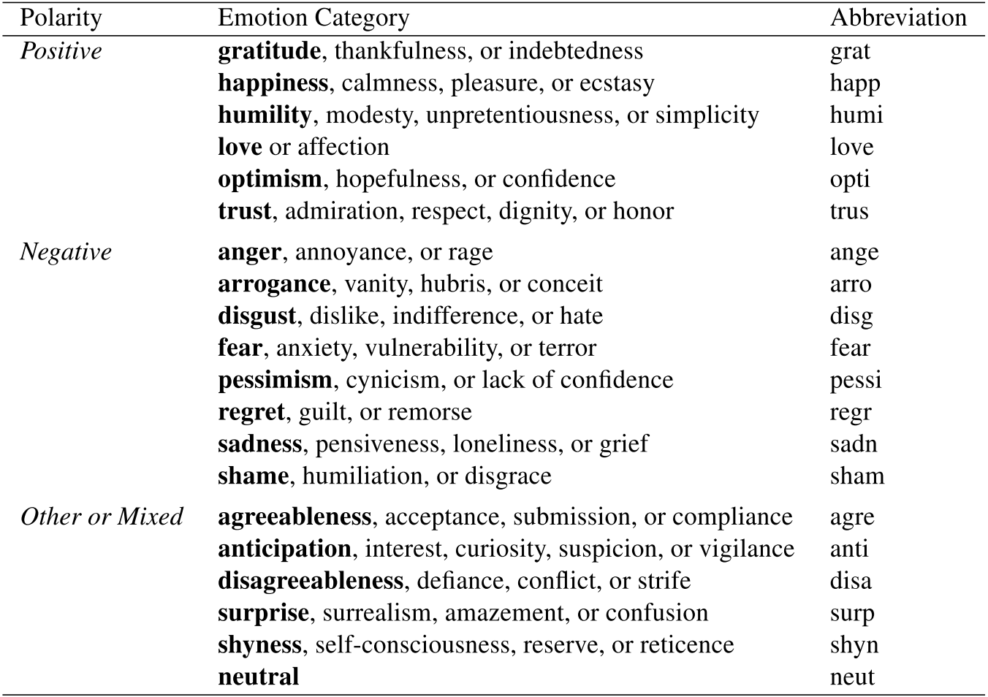
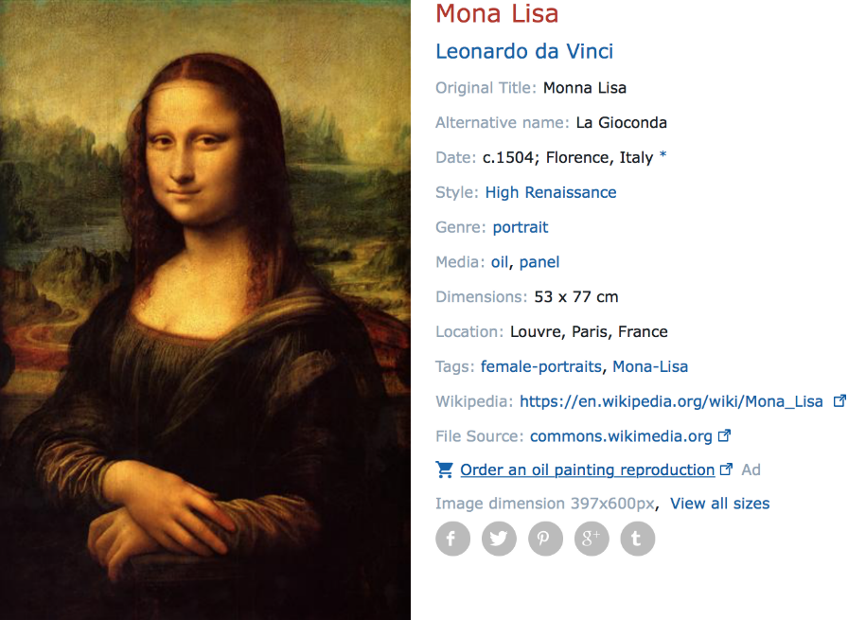
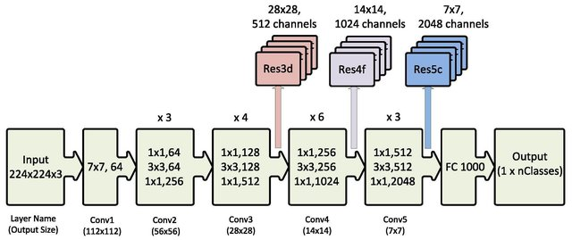
We trained ResNet50 on the WikiArt Emotions dataset to create a classifier to predict a subject’s propensity towards particular emotions, virtues, or iniquities.
WikiArt Emotions Dataset—4106 labeled images
ResNet50
What is “growth”?
What is “better” or “worse”?
How do we grow?

Slide 12
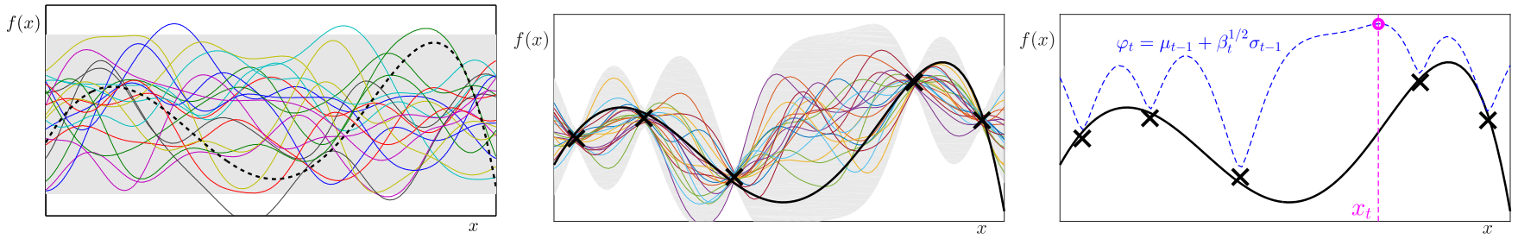
subject
Bayesian optimization
x = autoencoded features
autoencoding (1000→16)
choose new experience
experienced subject
We use Bayesian optimization to choose the images or ”experiences” to imbue the subject with.
database of ~46,000 art pieces
What is “growth”?
What is “better” or “worse”?
How do we grow?

Slide 13
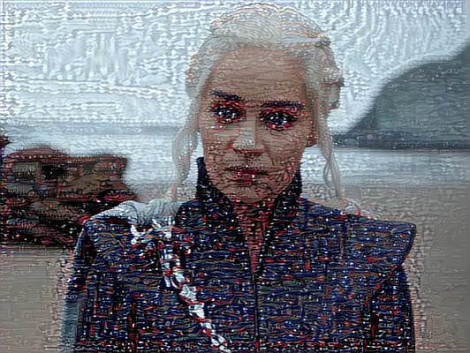
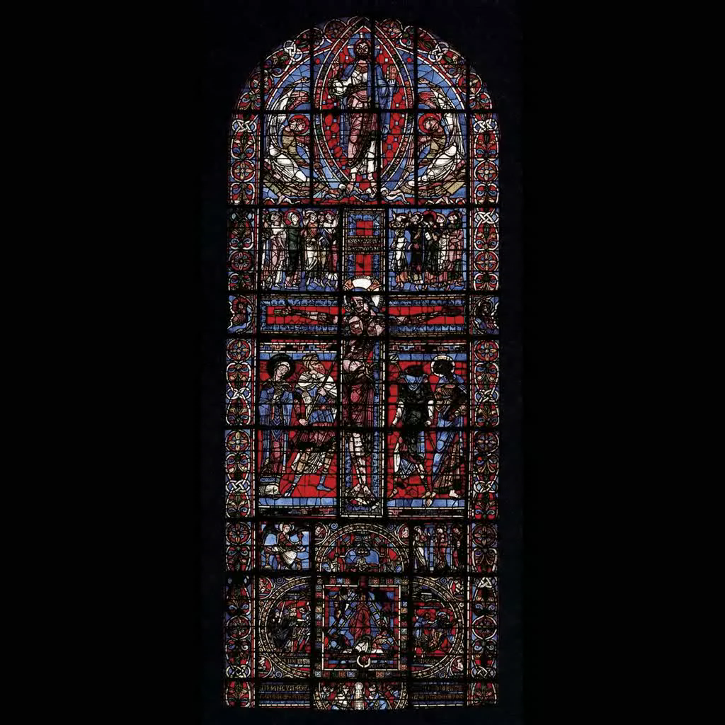
“Angry” Daenerys Targaryen
“angry” experiences

Slide 14
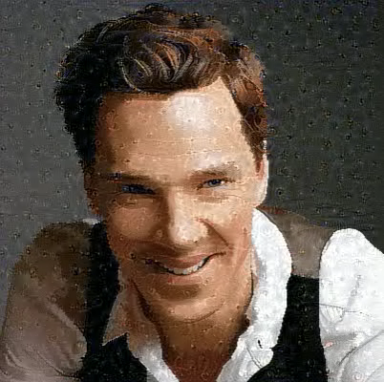
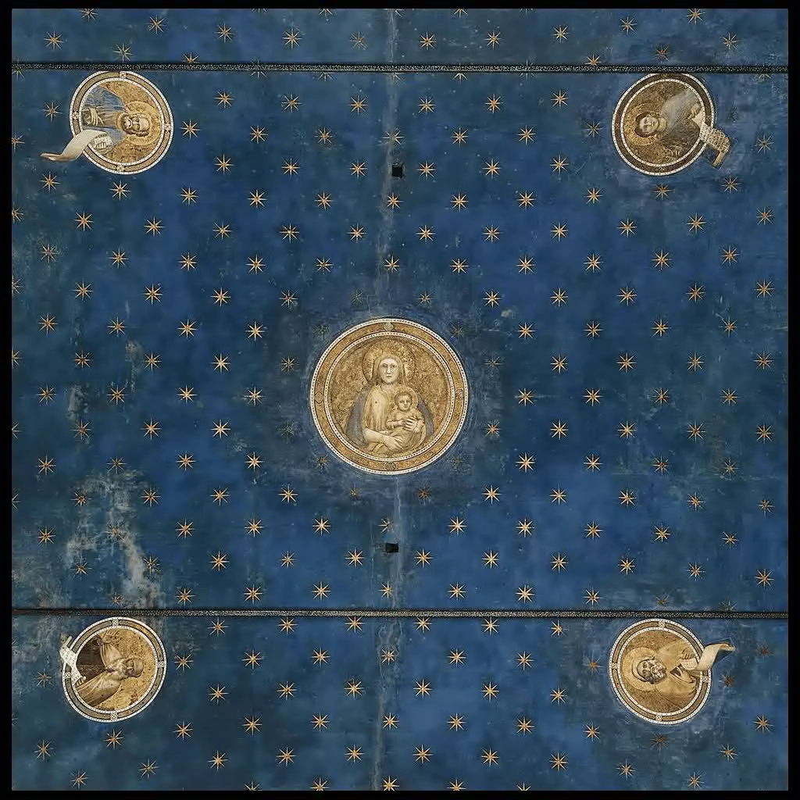
“Optimistic” Benedict Cumberbatch
“optimistic” experiences

Slide 15
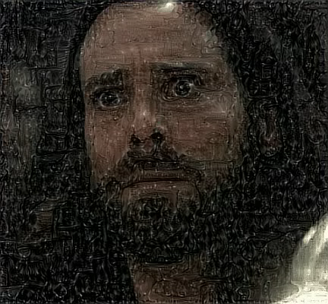
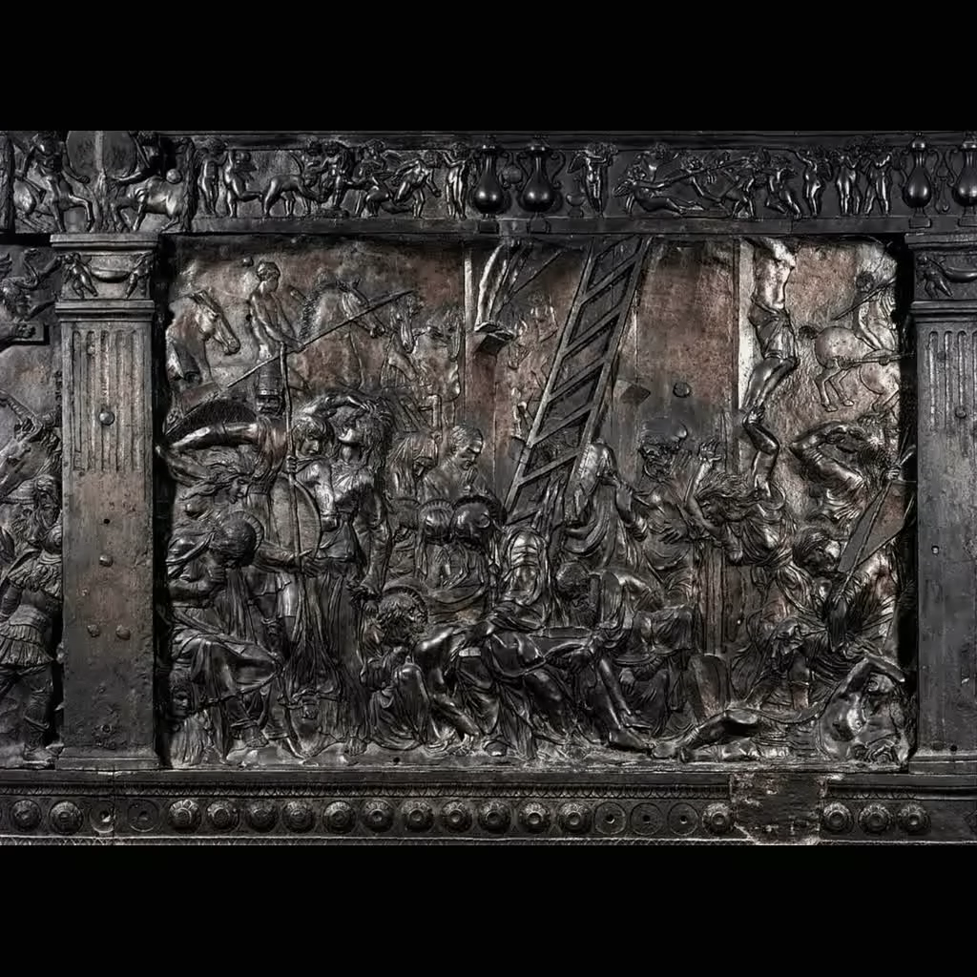
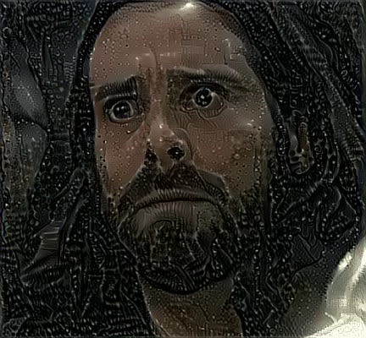
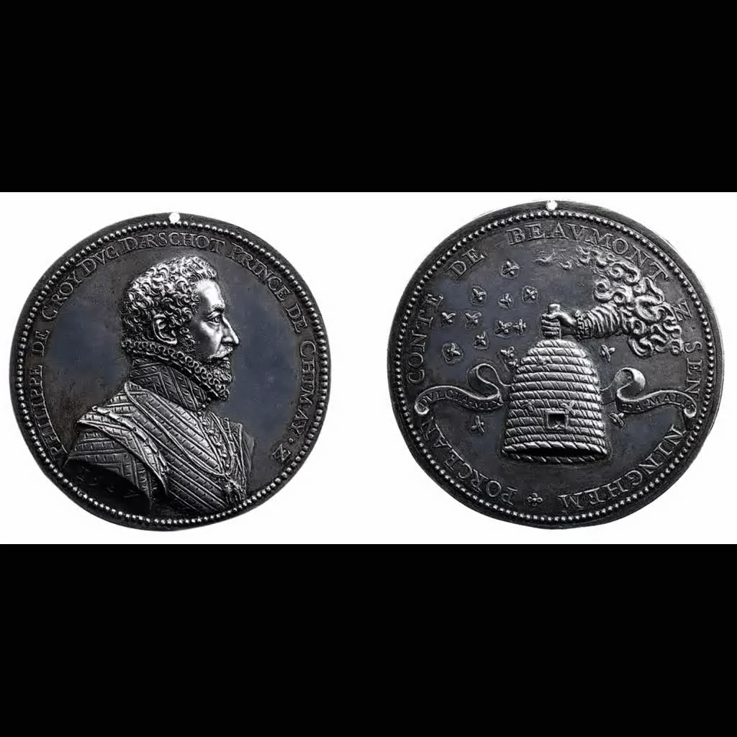
“Arrogant” Gaius Baltar
“arrogant” experiences
“Humble” Gaius Baltar
“humble” experiences

Slide 16
Thank you for watching!
See poster for future directions. Feel free to email with questions (Andrew ID: ktran)

